Slide 1

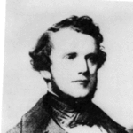
BPM: 2 Engineering Physics-II
UNIT –I: Crystal Structures and X-ray Diffraction
Lecture-6
By- Prof. B. K. Pandey, Dept. of Physics and Material Science
Auguste-Bravais

Slide 2

Miller Indices
Miller Indices are a symbolic vector representation for the orientation of an atomic plane in a crystal lattice and are defined as the reciprocals of the fractional intercepts which the plane makes with the crystallographic axes.
To determine Miller indices of a plane, take the following steps;
Choose a system of three coordinate axes , preferabally along the crstallographic axes.
Determine the intercepts of the plane along each of the three crystallographic directions usually along the coordinate axes x,y,z.

Slide 3
Miller Indices
Express these intercepts in the terms of axial unit.
Take the reciprocals of the intercepts.
Taking LCM of numerical values of above intercepts , reduce them to the smallest three integers which have same ratio.
Enclose the result of obtain in step-5 in the parentheses (hkl), which are known as Miller indices of the crystal plane.

Slide 4
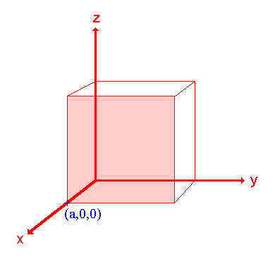
Example-1
Axis | X | Y | Z
Intercept points | 1 | ∞ | ∞
Reciprocals | 1/1 | 1/ ∞ | 1/ ∞
Smallest Ratio | 1 | 0 | 0
Miller İndices (100)
(1,0,0)

Slide 5
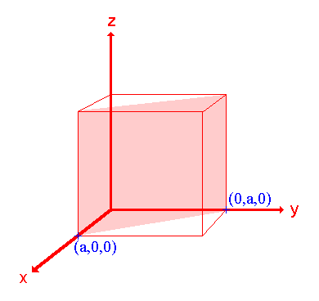
Example-2
Axis | X | Y | Z
Intercept points | 1 | 1 | ∞
Reciprocals | 1/1 | 1/ 1 | 1/ ∞
Smallest Ratio | 1 | 1 | 0
Miller İndices (110)
(0,1,0)
(1,0,0)

Slide 6
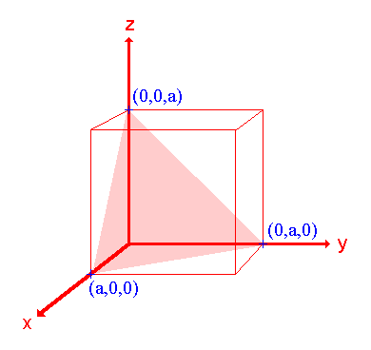
Example-3
Axis | X | Y | Z
Intercept points | 1 | 1 | 1
Reciprocals | 1/1 | 1/ 1 | 1/ 1
Smallest Ratio | 1 | 1 | 1
Miller İndices (111)
(0,0,1)
(0,1,0)
(1,0,0)

Slide 7
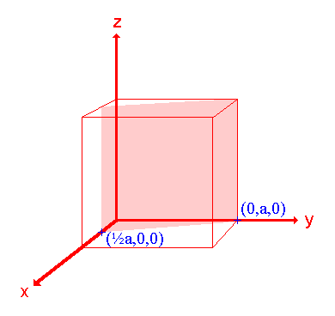
Example-4
Axis | X | Y | Z
Intercept points | 1/2 | 1 | ∞
Reciprocals | 1/(½) | 1/ 1 | 1/ ∞
Smallest Ratio | 2 | 1 | 0
Miller İndices (210)
(0,1,0)
(1/2, 0, 0)

Slide 8
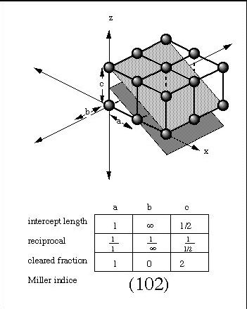
Example-5
Axis | a | b | c
Intercept points | 1 | ∞ | ½
Reciprocals | 1/1 | 1/ ∞ | 1/(½)
Smallest Ratio | 1 | 0 | 2
Miller İndices (102)

Slide 9
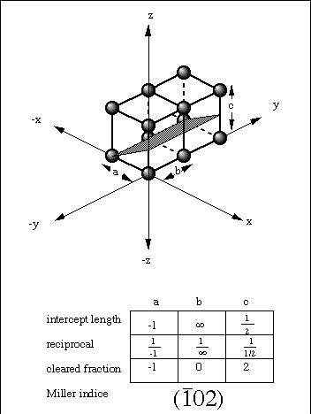
Example-6
Axis | a | b | c
Intercept points | -1 | ∞ | ½
Reciprocals | 1/-1 | 1/ ∞ | 1/(½)
Smallest Ratio | -1 | 0 | 2
Miller İndices (102)

Slide 10
Miller Indices
[2,3,3]
Plane intercepts axes at
2
Reciprocal numbers are:
Indices of the plane (Miller): (2,3,3)
2
Indices of the direction: [2,3,3]
3
(200)
(111)
(110)
(100)
(100)

Slide 11
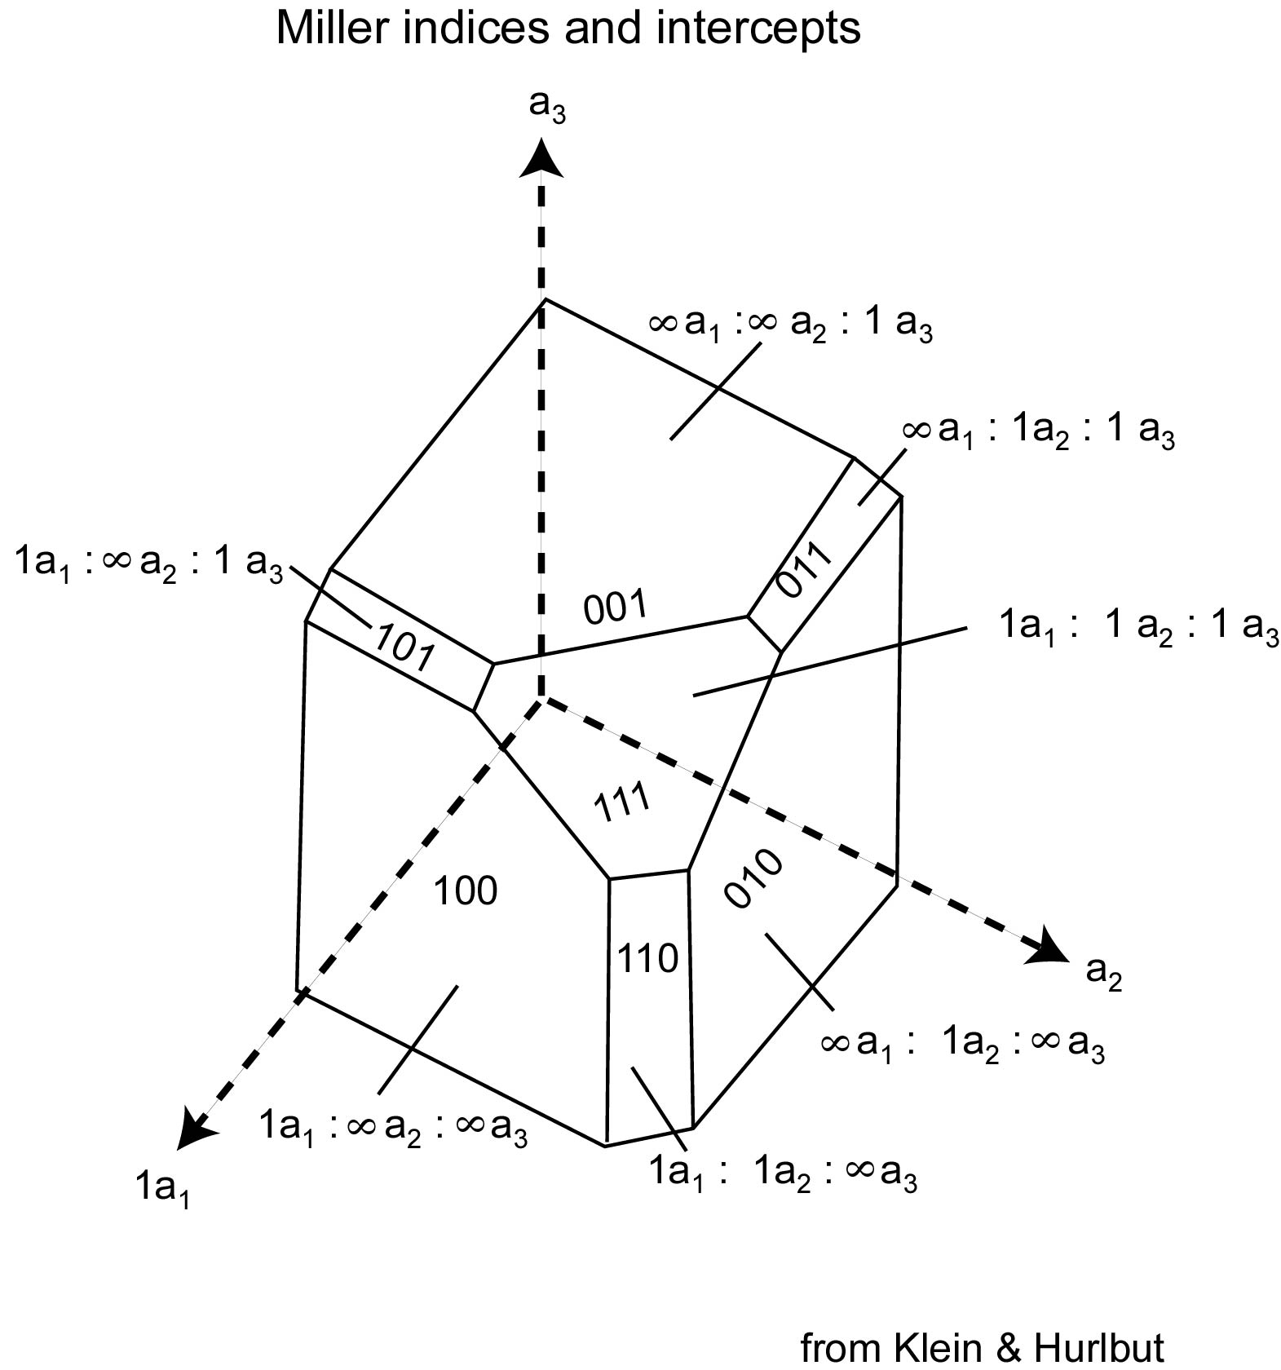

Slide 12
Example-7

Slide 13
THE MOST IMPORTANT CRYSTAL STRUCTURES
Sodium Chloride Structure Na⁺Cl⁻
Cesium Chloride Structure Cs⁺Cl⁻
Hexagonal Closed-Packed Structure
Diamond Structure
Zinc Blende

Slide 14
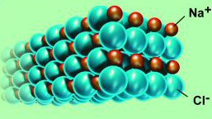
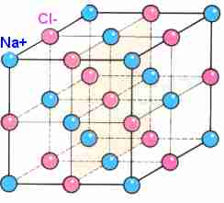
1 – Sodium Chloride Structure
Sodium chloride also crystallizes in a cubic lattice, but with a different unit cell.
Sodium chloride structure consists of equal numbers of sodium and chlorine ions placed at alternate points of a simple cubic lattice.
Each ion has six of the other kind of ions as its nearest neighbours.

Slide 15
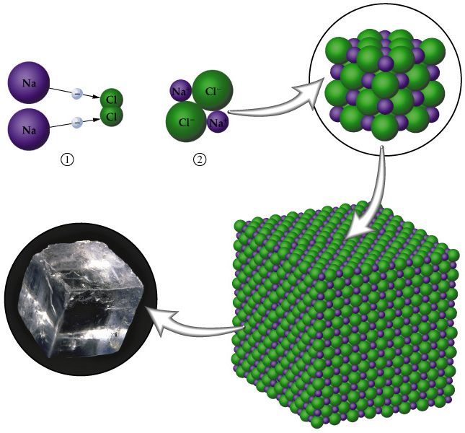

Slide 16
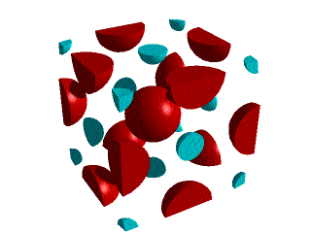
Sodium Chloride Structure
If we take the NaCl unit cell and remove all the red Cl ions, we are left with only the blue Na. If we compare this with the fcc unit cell, it is clear that they are identical. Thus, the Na is in a fcc sublattice.

Slide 17
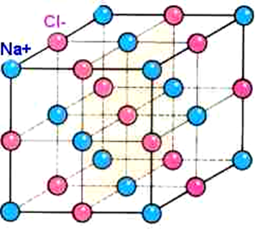
Sodium Chloride Structure
This structure can be considered as a face-centered-cubic Bravais lattice with a basis consisting of a sodium ion at 0 and a chlorine ion at the center of the conventional cell,
LiF,NaBr,KCl,LiI,etc
The lattice constants are in the order of 4-7 angstroms.

Slide 18
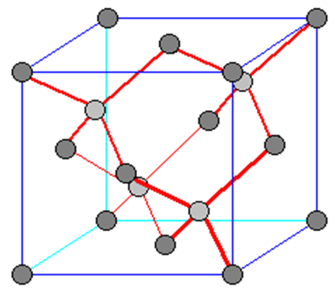
4 - Diamond Structure
The coordination number of diamond structure is 4.
The diamond lattice is not a Bravais lattice.
Si, Ge and C crystallizes in diamond structure.

